Slide 1
Overview of Basic Statistics in R cont.
DATA-LA 485
Notes:
9

Slide 2
What type of data is analyzed in chi-square tests?
Some examples include:
Number of people voting for different politicians
Numbers of students who pass or fail their degree in different subject areas
Whether children from different countries choose candy or sticker as prize
Chi-square test (of independence or association)

Slide 3
An example
Can animals be trained to line-dance with different rewards?
Participants: 200 cats
Training
The animal was trained using either food or affection, not both
Dance
The animal either learned to line-dance or it did not
Outcome:
The number of animals (frequency) that could dance or not in each reward condition
We can tabulate these frequencies in a contingency table
An Example: Dancing Cats and Dogs

Slide 4
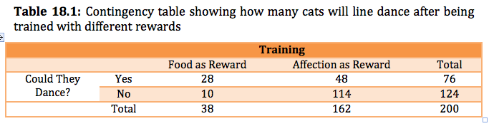
A Contingency Table
NOTE: Each person, item or entity contributes to only one cell of the contingency table.

Slide 5
What is the null and alternative hypothesis?
H_{o}: p₁ = p₂ (proportions are equal)
H_{a}: p₁ ≠ p₂
Pearson’s chi-square test

Slide 6

Pearson’s Chi-Square Test
The equation:
The observed data are the frequencies the contingency table
The ‘model’ is based on ‘expected frequencies’.
Calculated for each of the cells in the contingency table.
n is the total number of observations (in this case 200).

Slide 7
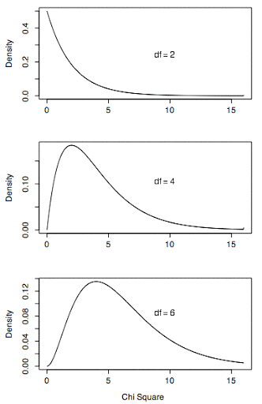
Test statistic – X²
Checked against a chi-square distribution with (r − 1)(c − 1) degrees of freedom.
If significant then there is a significant association between the categorical variables in the population.
How do we know if it’s significant?

Slide 8
What are the assumptions of the chi-square test?
Independence:
Each person, item or entity contributes to only one cell of the contingency table.
If violated, check out McNemar test or Cochran test
The expected frequencies should be greater than 5.
In larger contingency tables up to 20% of expected frequencies can be below 5, but there a loss of statistical power.
Even in larger contingency tables no expected frequencies should be below 1.
If violated, use Fisher’s exact test.
Important Points

Slide 9

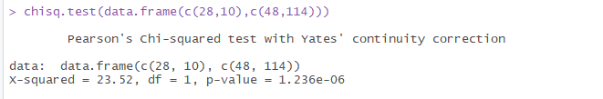

Enter data into R:
cont_table <- data.frame(danced=c("yes", "no"), food=c(28,10), affection=c(48,114))
cont_table
Run chi-square test:
cont_table %>% select(-danced) %>% chisq.test()
OR
chisq.test(data.frame
How to conduct in R?
Notes:
What is Yates’ continuity correction?
If you only have 1 degree of freedom, you need to do a correction because the overestimates the chi-square test statistic, so we subtract ½ from the numerator of our test statistic before squaring
9

Slide 10

Cramer’s V statistic
where k is the min(r,c)
CramerV()
Effect Sizes

Slide 11
The statistical test is preceded by the descriptive statistics.
The description tells you what the null hypothesis being tested is
A “stat” block is included
The results are interpreted
Communicating Results
Of the 200 cats trained in this experiment, 38 were trained with food as a reward, while 162 were trained with affection as the reward. A chi-square test for association with Yates continuity correction was conducted to test whether there was an association between training type and dancing. Results show a significant association between the type of training and whether or not cats would dance χ²(1) = 25.36, p < .001. Based on the odds ratio, the odds of cats dancing were 6.65 times higher if they were trained with food than if trained with affection.

Slide 12
Check out DrivenData competition page:
https://www.drivendata.org/competitions/7/pump-it-up-data-mining-the-water-table/
Goal for today

